Slide 1
Culmination Exercise Briefing
Peter Burbery, Quinton Green, Jake Harms, Hyacinthe Howell, Jesseca Montcrieff, Matt Penn, Sarah Welsh, Ethan White
Notes:
I am the team leader. By I, I mean Peter Burbery.

Slide 2
Our Mission
Pathfinder Team SPF conducted a Grey-box pentest against Pathfinder Inc. Systems. The team executed this exercise in both a Windows, Linux & Web environment to explore if the company met compliance requirements.
Objectives
Use Network Scanning and Enumeration to validate Network Security.
Utilize Directory Brute Forcing and SMB to observe Data Confidentiality.
Attempt Password Cracking to test Password Security and Access.
Explore various methods of exploitation to develop a comprehensive security overview.

Slide 3
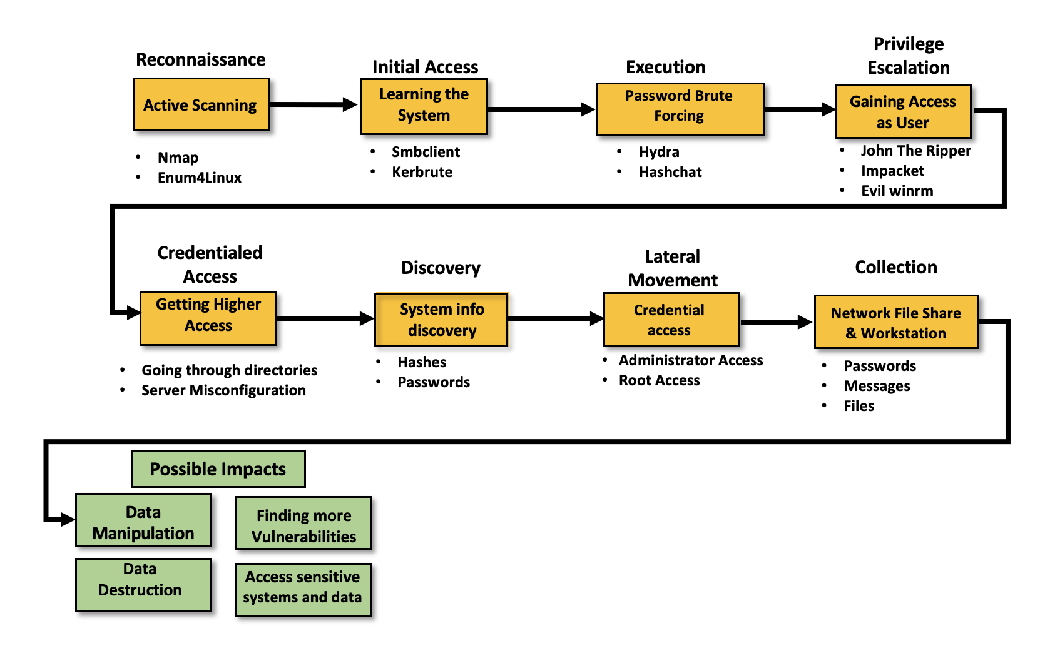
MITRE ATT&CK Framework

Slide 4
Linux Testing

Slide 5
Key Findings
Outdated version of SMB - HIGH PRIORITY
Disable SMBv1
Anonymous access for shares - HIGH
Disable guest/anonymous access
Block 139/445 at firewall
Outdated web and application server version - HIGH
Upgrade Jserv protocol from 1.3, remote commands CURRENTLY ALLOWED
Upgrade Apache httpd 2.x, partial HTTP requests can cause denial of service.
Improper Web Server Access Controls - MEDIUM
Implement proper Access Controls
Implement rate limiting to prevent bruteforcing

Slide 6
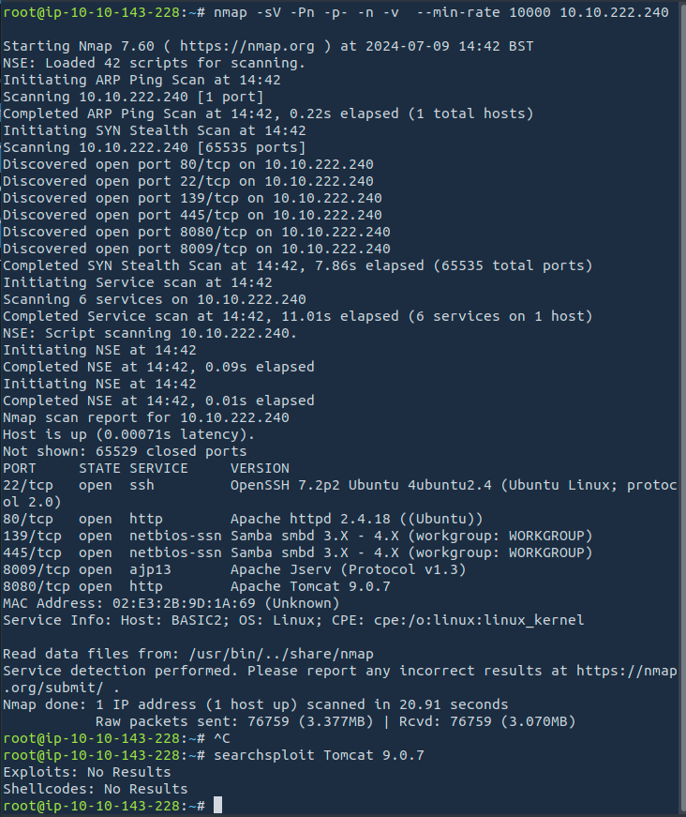
NMAP Enumeration
Initial scan for active reconnaissance
Service name, all ports, verbose, no DNS resolution
Interesting ports are 139, 445, 8009, and 8080
139/445 are SMB
8080 is a secondary web server
8009 communicates between the web server and application server

Slide 7
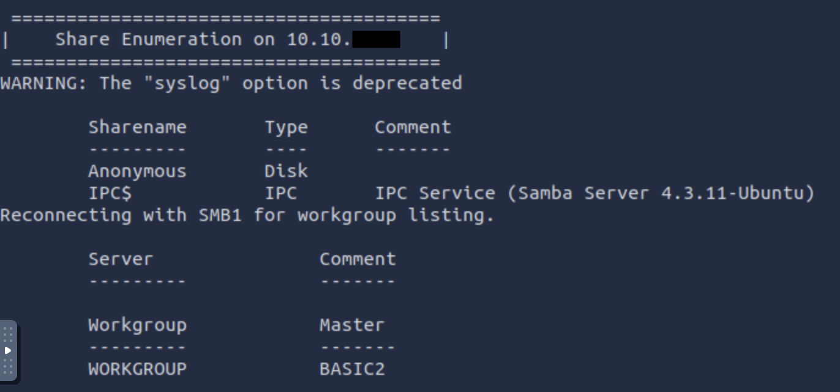
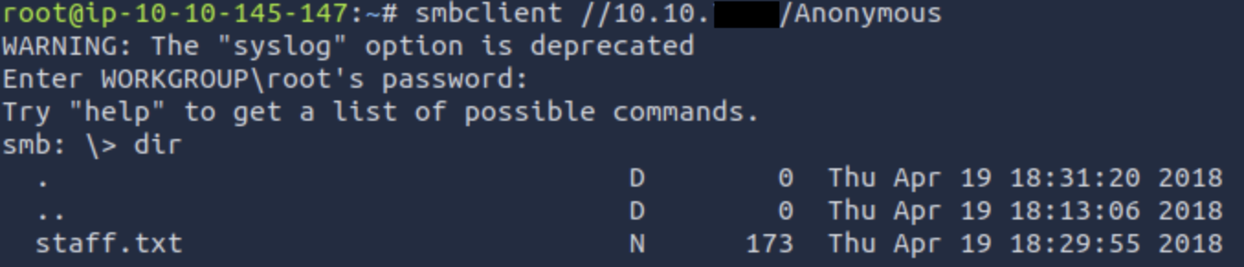
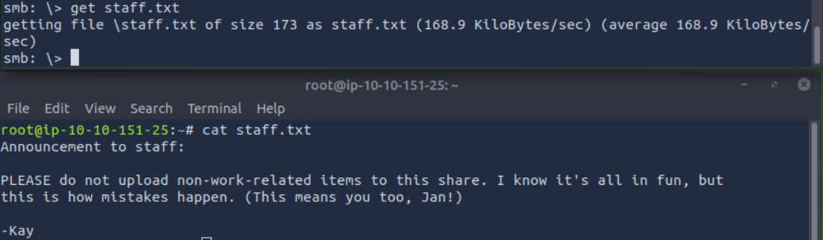
SMB Enumeration
139/445 were interesting ports
Used enum4linux as a tool to find active shares (file directories) being broadcasted
Found “Anonymous” share available, login without a user/creds.
This share was available for anyone to connect and contained a message to Jan!

Slide 8
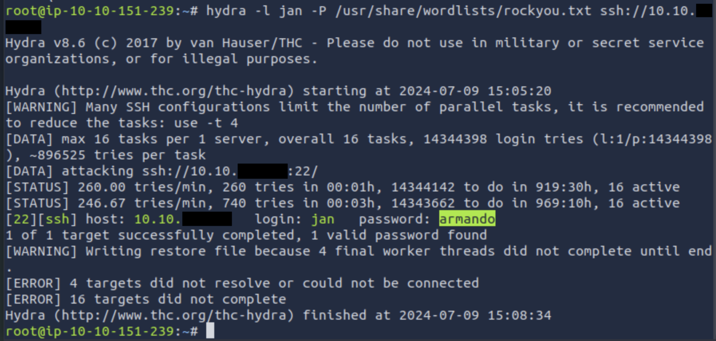
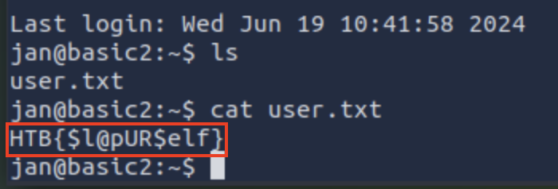
Unauthorized Access
Used hydra to bruteforce Jan’s Password with a wordlist
Using the cracked password we can log into Jan’s account through ssh
Weak passwords can be easily “guessed” by the machine in a matter of seconds
Flag found through Jan’s root directory after using their SSH login

Slide 9
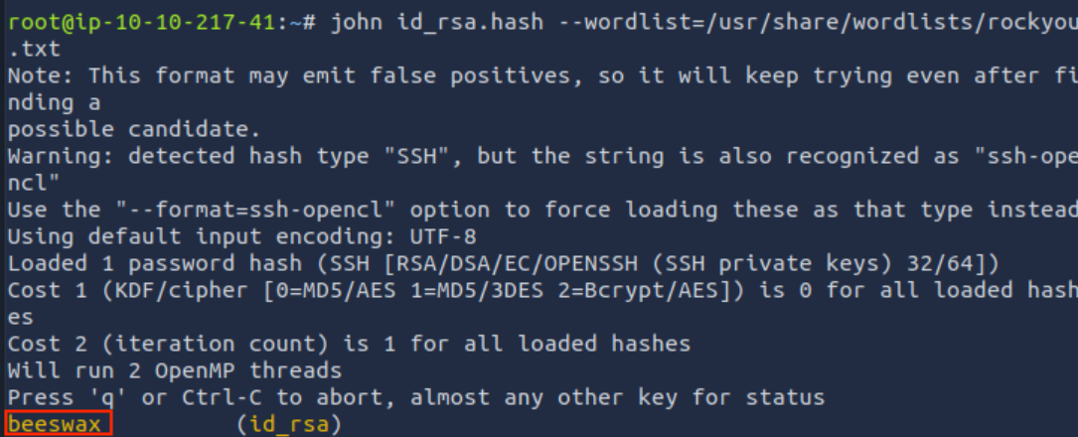
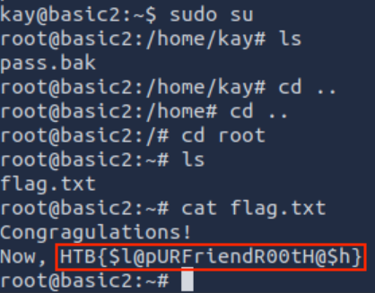
Privilege Escalation
Jan had access to Kay’s directory, so we could download her private ssh key and decrypt it with John the Ripper to find her passphrase
Logged into Kay’s through ssh with her private key to get into her system
From there gained administrator access and found the directory where the second flag was located and obtained the root flag

Slide 10
Windows Testing

Slide 11
Initial Access
We get usernames from the about page.
The contact page also gives us the domain and the format of the usernames.
We verify the usernames with KerBrute.
We find a user without pre-authentication with impacket-GetNPUsers which gives us a hash.
We get the password from the hash with hashcat.
We obtain non-administrator access to the machine with evil-winrm.

Slide 12
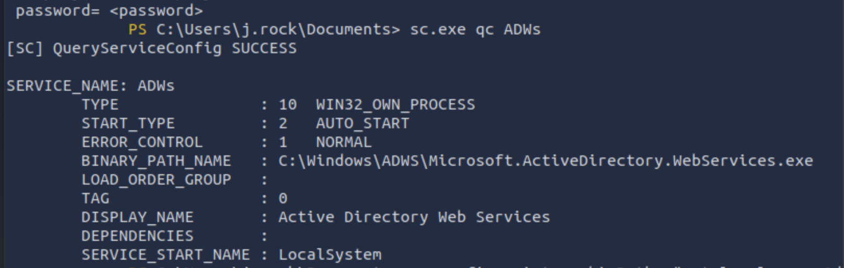
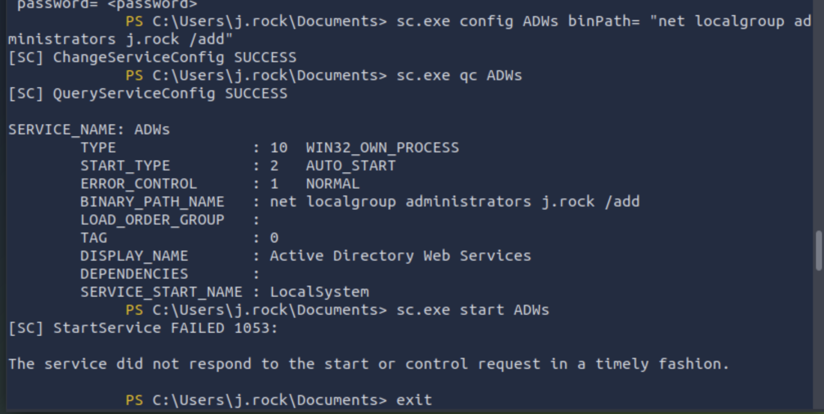
User Access
Gaining access to any user’s login credentials can lead to an array of vulnerabilities
Found j.rock had privs to modify multiple services, including Active Directory Web Services
Modified the vulnerable ADWs to add j.rock (a normal user) as an Admin
Once an attacker has gained administrator privileges, they have the master key to your system
Notes:
Especially if there are weak security configurations already present

Slide 13
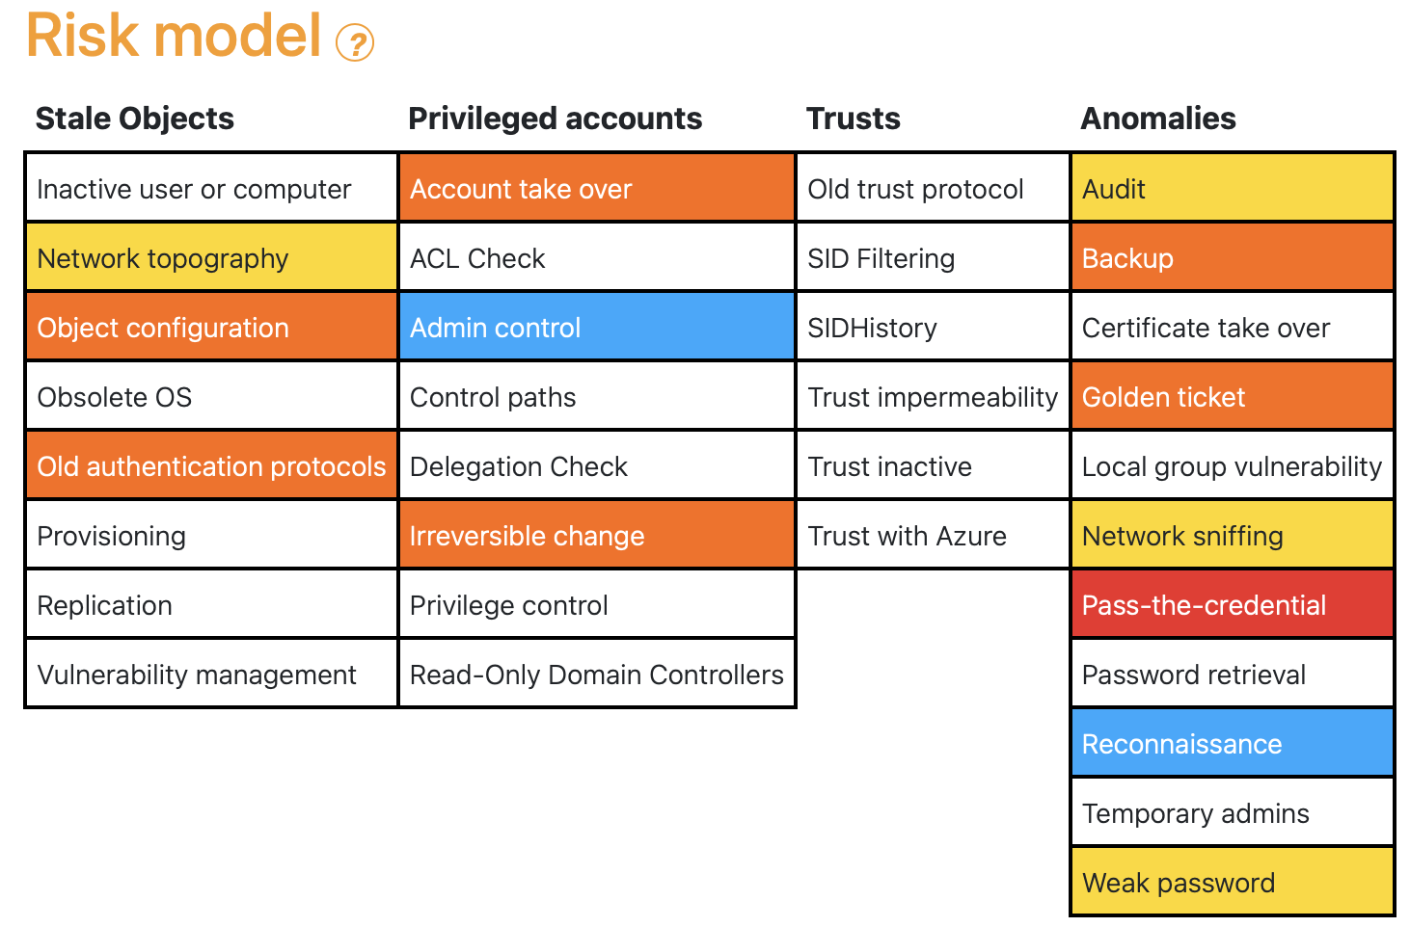
Notes:
Red = Critical, Orange = High Risk, Yellow = medium risk, blue = no risk, improvements recommended

Slide 14
Remediation
Enable Kerberos Pre-Authentication.
Reconfigure service permissions. (ADWS)
Implement a password policy. (Dictionary Attack)
Must keep Windows server and services updated with latest security patches.
Regularly conduct security audits.

Slide 15
Potential Impact
Reputation Damage:
Loss of business, customer trust.
DoS attacks and other exploited vulnerabilities:
Experience downtime, loss of customers
Financial Losses:
Theft of funds, ransom payments and proprietary information could be leaked and sold.
Financial Consequences:
Legal fines if sensitive information is compromised, assets can be stolen.

Slide 16
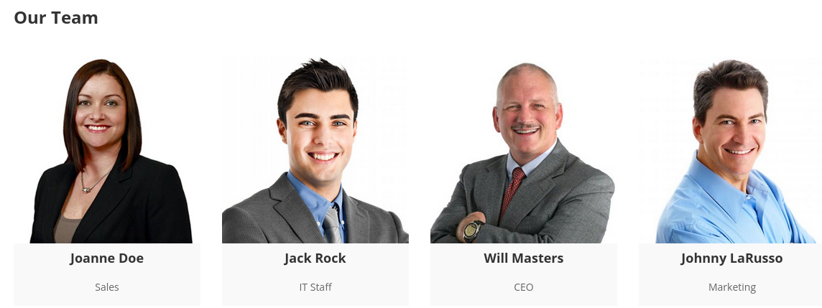
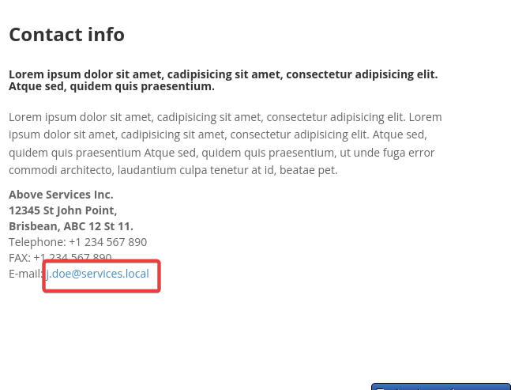
Finding usernames
http://10.10.34.96/about.html
The usernames are found from about us.
What is the format of the usernames?
email:j.doe@services.local. We learn that the domain is services.local. We also have an idea of the format of the usernames, giving us j.doe, j.rock, w.masters, and j.larusso.
This also tells us how their IT staff likes to structure their emails. <firstLetterOfFirstName>.<lastname>@services.local

Slide 17
Users (continued)
Jack Rock should be of special interest because of his IT position.

Slide 18
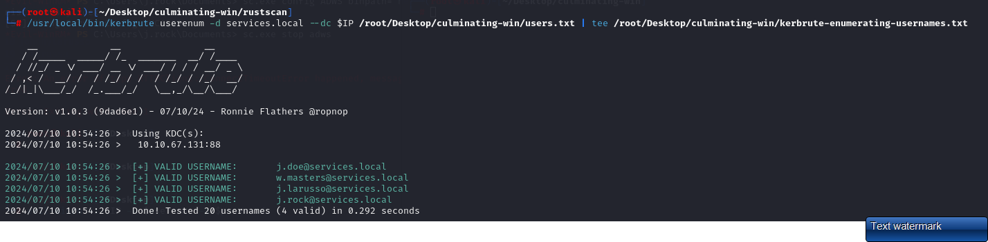
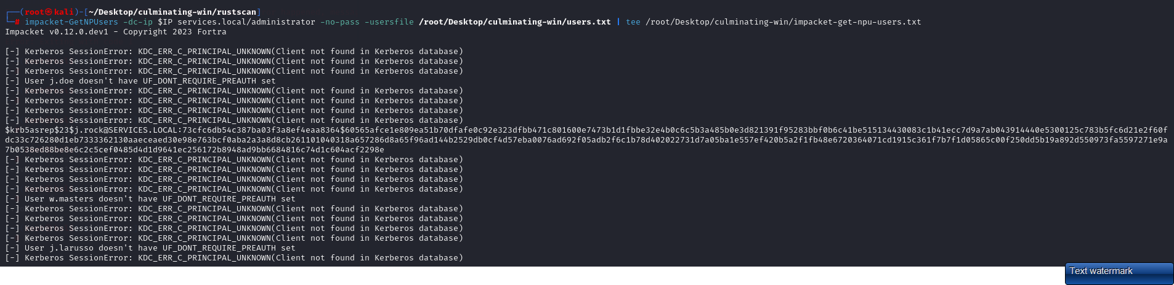
KerBrute
We find valid usernames with Kerbrute.
Finding users with no preauthentication
We use impacket-GetNPUsers, which is built into Kali Linux, to discover a hash.

Slide 19
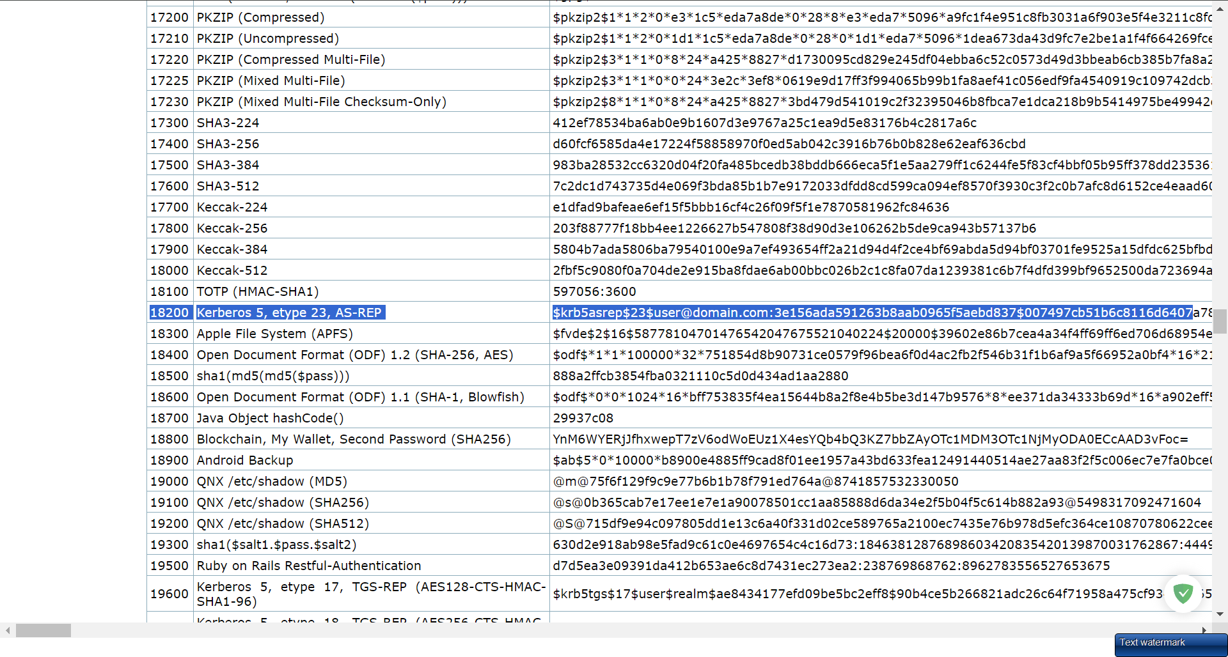
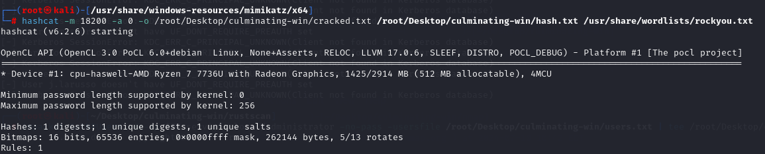
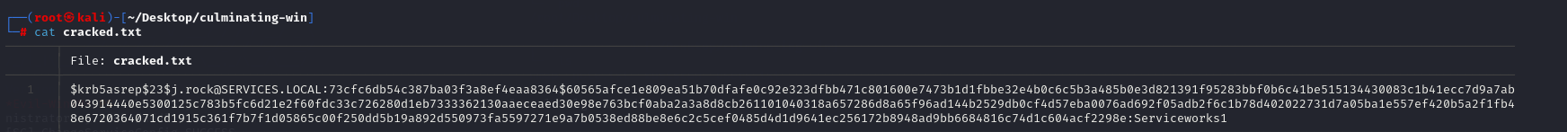
Find the format of the hash with Hashcat Wiki
We get the password from the hash and store the hash in a text file hash.txt
Crack the hash

Slide 20

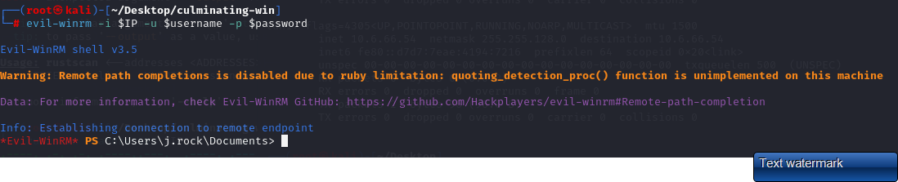
Evil-winrm
We connect to the machine with evil-winrm.

Slide 21
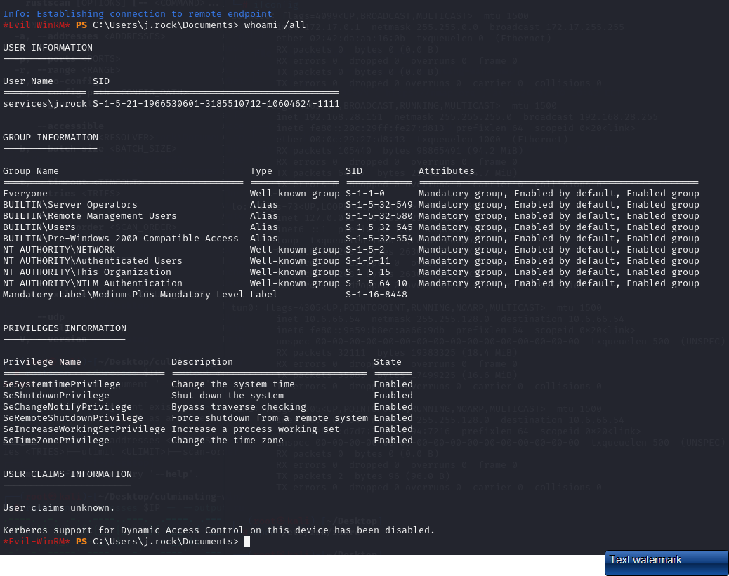
Privilege Escalation
The next step is to become an Administrator.

Slide 22
What method should be used to escalate?
Since the box is named ‘services’, the probability that we need to abuse some service is high, so I wanted to enumerate them further.

Slide 23
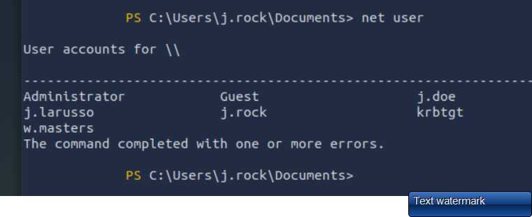
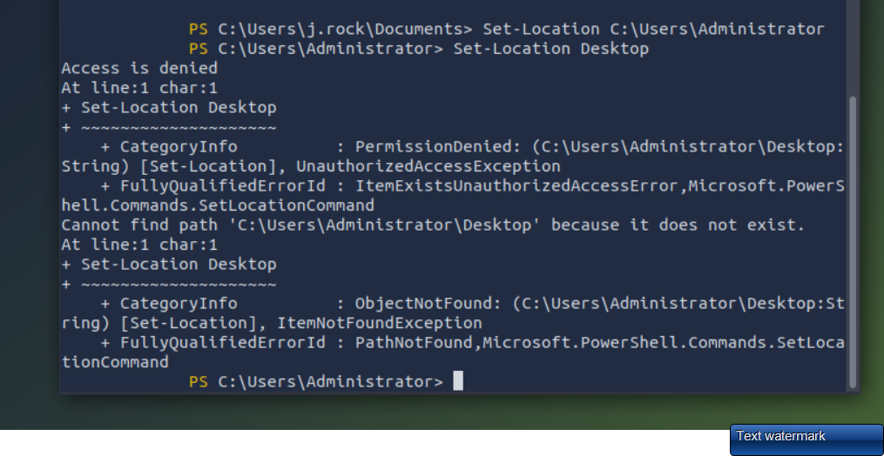
Users
These are the users.
The flag is on Administrator’s Desktop. We do not have read access to Administrator’s Desktop so we must become an administrator to read the file and obtain the flag.

Slide 24
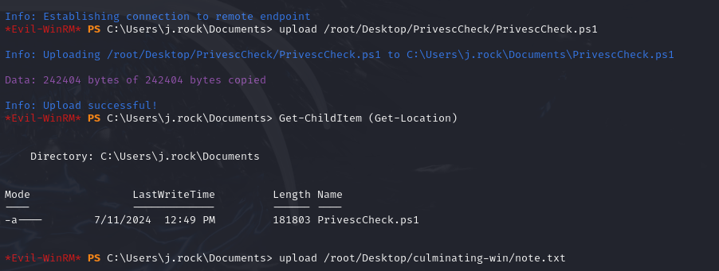
Uploading PrivescCheck
We upload PrivescCheck with evil-winrm.
In this exercise I learned that evil-winrm supports uploading files. The only requirement is that you start evil-winrm in the directory of the file you want to upload.

Slide 25
Generating a report with PrivescCheck
PrivescCheck is available at https://github.com/itm4n/PrivescCheck.
We run .\PrivescCheck.ps1; Invoke-PrivescCheck -Extended -Report PrivescCheck_$($env:COMPUTERNAME) -Format TXT,HTML
We then download the HTML report and look for things with high, which is marked with red.

Slide 26
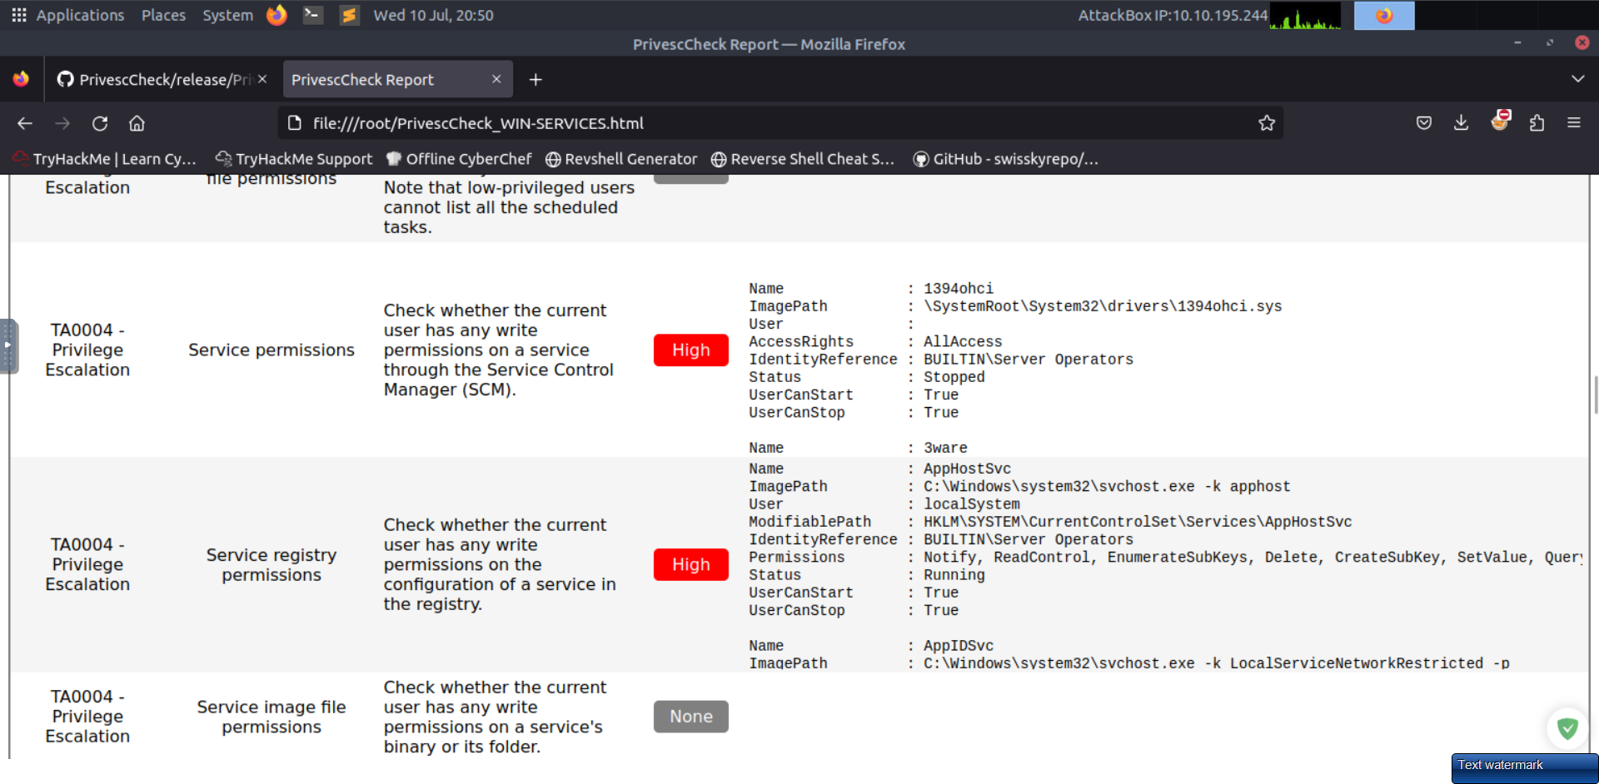
Finding vulnerabilities
We use PrivescCheck.ps1.

Slide 27
We work to exploit ADWS

Slide 28
Sources
TryHackMe writeups and walkthroughs and guides
https://medium.com/@madfoxsec/services-tryhackme-writeup-bf6bc6fc105
https://boxalarm.tech/services-writeup-tryhackme-109745591e80
https://github.com/itm4n/PrivescCheck

